Slide 1
Azure SQL Database
Srini Alavala
Cloud Solution Architect

Slide 2
Azure Relational Database Platform
Power BI
Azure App Services
Azure Data Factory
Azure Analysis Services
Azure Machine Learning
Azure Cognitive Services
Azure Bot Service
Azure SQL Database
SQL Data Warehouse
PostgreSQL
MySQL
MariaDB
Database Services Platform
Intelligent Advisors, tuning, monitoring
Flexible On-demand scaling, resource governance
Trusted HA/DR, backup/restore, security, audit, isolation
Azure compute
Azure storage
Global Azure in 54 regions

Slide 3
Migrate to the cloud with Azure SQL Database
Breakthrough productivity & performance
Industry-leading security
Built-in intelligence
Seamless and compatible
Competitive TCO
Up to 100 TB of on-demand scalable storage per DB
Layers of security and 99.99 percent availability SLA
Intelligent performance tuning and intelligent protection
The broadest SQL Server compatibility and VNET support
Up to 80% savings with Azure Hybrid Benefit and reserved capacity
The best and most economical cloud destination
Notes:
Breakthrough productivity & performance
Experience up to 30x improved throughput and latency and up to 100x faster queries and reports with in-memory technologies.¹ In-memory OLTP can dramatically improve throughput and latency on transactional processing workloads and can provide significant performance improvements.
Dynamic scalability enables your database to transparently respond to rapidly changing resource requirements across all service tiers: Basic, Standard, Premium (Single databases and elastic pools); General Purpose and Business Critical (Managed Instance). Scale your app from a handful of databases to thousands and manage unpredictable demand patterns, within a budget and resources you control with elastic pools.
Support for 100TB+ databases with Hyperscale
Industry-leading security
Protect sensitive data with Transparent Data Encryption and Dynamic Data Masking
Proactively monitor for vulnerabilities and threats with intelligent Advanced Threat Protection
Enable database access control with multifactor authentication using Azure Active Directory authentication. You can centrally manage the identities of database users and other Microsoft services in a single location. Central identity management provides a single place to manage Azure SQL Database users and simplifies permission management.
Built-in Intelligence
Intelligent Performance learns unique database patterns and automatically tunes for improved performance
Adaptive Query Processing. Accelerate parallel queries and improve scaling of frequent queries with Intelligent Query Processing

Slide 4
Azure SQL Database deployment options
SQL
Azure SQL Database
Single
Elastic Pool
Managed Instance
Database-scoped deployment option with predictable workload performance
Shared resource model optimized for greater efficiency of multi-tenant applications
Instance-scoped deployment option with high compatibility with SQL Server and full PaaS benefits
Best for apps that require resource guarantee at database level
Best for SaaS apps with multiple databases that can share resources at database level, achieving better cost efficiency
Best for modernization at scale with low friction and effort
Notes:
Introducing Azure SQL Database Managed Instance
SQL Database Managed Instance is an expansion of the existing SQL Database service designed to enable database migration to a fully-managed database service, without re-designing the application.
It’s important to note that Managed Instance isn’t a new service – it is a third deployment option within Azure SQL Database, sitting alongside single databases and elastic pools. As part of Azure SQL Database, Microsoft’s fully managed cloud database service, it inherits all its built-in features.
A SQL Database Managed Instance offers a simplified instance-scoped programming model that is like an on-premises SQL Server instance. The databases in a SQL Database Managed Instance share the resources allocated to the Managed Instance, and the Managed Instance also represents the management grouping for these databases. The emphasis of this offering is on high compatibility with the programming model of an on-premises SQL Server and out-of-box support for a large majority of SQL Server features and accompanying tools/services.
Each standalone database is assigned a certain amount of resources via performance tiers: Basic, Standard, and Premium. The emphasis of this offering focuses on a simplified database-scoped programming model and applications with a predictable pattern and relatively stable workload.
An elastic database pool is a shared resource model that enables higher resource utilization efficiency, and all the databases within an elastic pool share predefined resources within the same pool. The emphasis of this offering is on a simplified database-scoped programming model for multi-tenant SaaS apps. The workload pattern is well-defined and is highly cost-effective in multi-tenant scenarios. For ISVs with SaaS apps, the savings can be significant, in the hundreds of thousands of dollars or more.

Slide 5
Industry-leading security
Always Encrypted
Threat Detection
Client side
Server side
Master key
Encrypted columnar key
Threat detection
Alert
Apps
Encrypted query
TCE-enabled ADO .NET library
No app changes
Multifactor authentication
CreditCardNo
Table.CreditCardNo
4465-6571-7868-5796
4468-7746-3848-1978
4484-5434-6858-6550
XXXX-XXXX-XXXX-5796
SQL Database
XXXX-XXXX-XXXX-1978
Real-time data masking, partial masking.
Dynamic Data Masking
Customer 1
Customer 2
Customer 3
Notes:
Always Encrypted
Protect data at rest and in motion, on premises and in the cloud
Transparent client-side encryption, while SQL Server executes T-SQL queries on encrypted data
Benefits
Sensitive data remains encrypted and queryable at all times on-premises and in the cloud
Unauthorized users never have access to data or keys
No application changes
Dynamic Data Masking
Prevent abuse of sensitive data by hiding it from users
Easy configuration in new Azure Portal
Policy-driven at table and column level, for a defined set of users
Data masking applied in real-time to query results based on policy
Multiple masking functions available, such as full or partial, for various sensitive data categories (credit card numbers, SSN, etc.)
Threat Detection
Detect anomalous database activities that could indicate a potential threat
Configure threat detection policy in Azure Portal
Receive alerts from multiple database threat detectors that identify anomalous activities
Explore audit log around the time of an event

Slide 6
How Always Encrypted works
Encrypted sensitive data and its corresponding keys are never seen in plaintext in SQL Server
Trusted – Client
Untrusted – SQL Server
ADO.NET
"SELECT Name FROM Customers WHERE SSN = @SSN",
"111-22-3333"
"SELECT Name FROM Customers WHERE SSN = @SSN",
0x7ff654ae6d
ciphertext
SQL
Result set
Result set
Name
Jim Gray
Name
0x19ca706fbd9a
dbo.Customers
Name | SSN | Country
0x19ca706fbd9a | 0x7ff654ae6d | USA
ciphertext
Notes:
Objective: Always Encrypted-enabled driver installed on the client computer achieves this by automatically encrypting and decrypting sensitive data in the SQL Server client application.
Talking Points:
The driver encrypts the data in sensitive columns before passing the data to SQL Server, and automatically rewrites queries so that the semantics to the application are preserved. Similarly, the driver transparently decrypts data, stored in encrypted database columns, contained in query results. Here are the details on how these feature works
Users specify individual columns of particular tables to be encrypted
Once encrypted, the data appears as an encrypted binary blob at all stages within the SQL Server database: on disk, in memory, during computations, and over the network
Users use a certificate store to save the encryption key.
Both encryption and decryption are done by the ADO.Net SqlClient driver for .Net 4.6. This driver will require access to the encryption key (via the certificate store, generally) and thereafter will communicate with the SQL Server directly to effect transparent encryption.
Specifically, when queries are parameterized, SqlClient will handshake with the SQL Server and identify which parameters are encrypted and will manage this process in both directions.
Example: the client code specifies a select statement with the parameter “where SSN = @SSN” and provides the parameter value “@SSN=’123-45-6789′” and the driver itself intercepts the parameter value and properly encrypts it

Slide 7
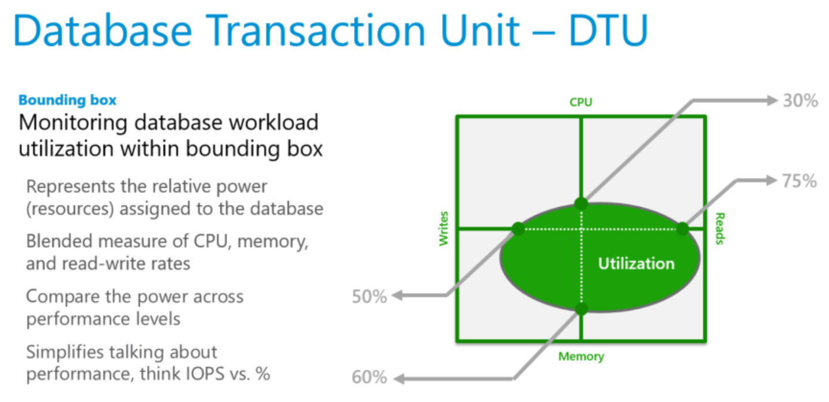
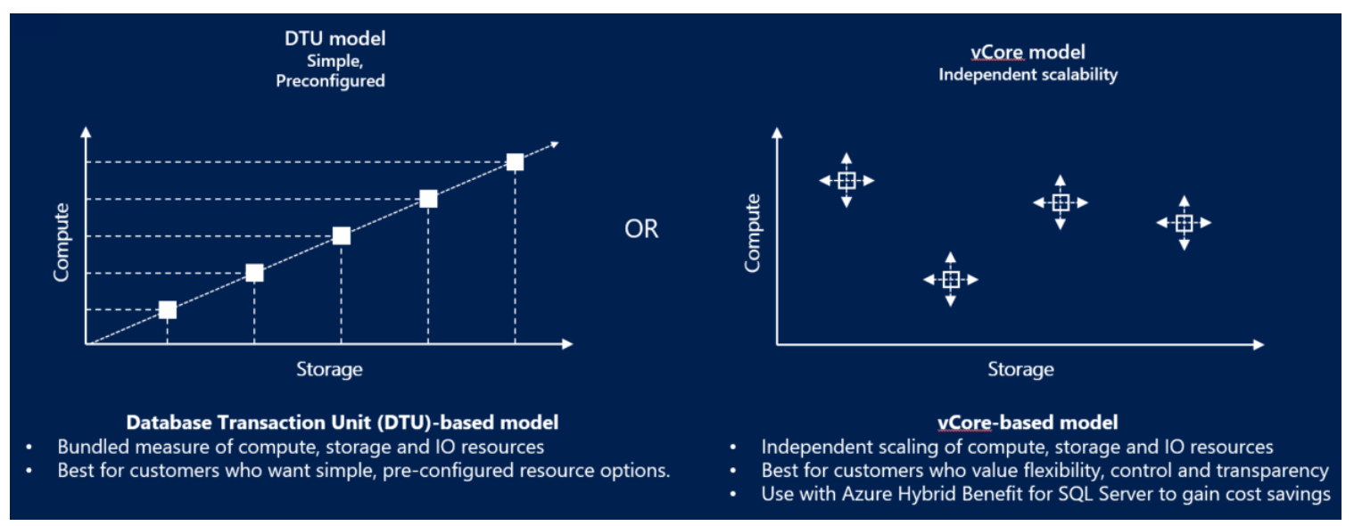

Slide 8



Azure SQL Database Tiers
Tiers
DTUs
VCores
1:1
Basic
2GB
General Purpose
Hyperscale
Business Critical
4 TB
100 TB
Standard
1TB
Provisioned
8 TB
Premium
4TB
Serverless

Slide 9
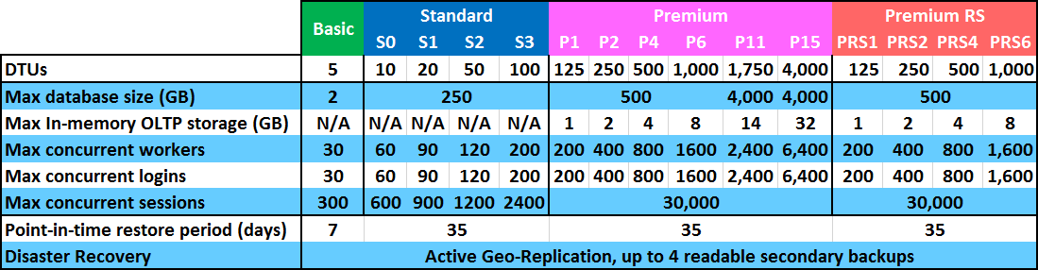
Determine your service tier
The Basic, Standard, and Premium/Premium RS service tiers offer differing feature sets, so the first step in selecting an appropriate tier is to determine the service tier that provides the minimum level of feature capabilities required for your application and business.
Notes:
Talking Points:
Determine service tier based on feature capability
The Basic, Standard, and Premium/Premium RS service tiers offer differing feature sets, so the first step in selecting an appropriate tier is to determine the service tier that provides the minimum level of feature capabilities required for your application and business.
For example, consider how long backups need to be retained, or if standard or active geo-replication features are needed, or the overall maximum database size needed, etc. These requirements determine your minimum service tier choice.
The Basic tier is primarily used for very small, low activity databases. So, for an upgrade you should usually start with the Standard or Premium tier based on the minimum level of required features.
Premium RS tier provides the same performance levels, security features and business continuity features as the Premium tier albeit at a reduced SLA

Slide 10



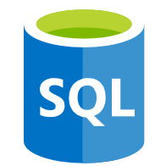
Today Hands-on Lab I
Resource Group
Virtual Machine
2012
Sql Db target
Data Masking
Encryption

Slide 11




Azure Database Migration Service (Azure DMS)
On-prem network
Cloud network
SQL
My
SQL Server
2005 - 2017
My
Internet
VPN or Express Route
Azure DMS
SQL
SQL
Assessment tools
SSMA & DMA

Slide 12
Lift your SQL server integration services (SSIS) packages to azure
Azure Data Factory
SSIS Integration Runtime
SQL
Easily execute and schedule your SQL Server Integration Services (SSIS) packages in managed execution environment for SSIS in Azure Data Factory version 2 (ADF v2)
Gain high availability, scalability and lower TCO by lifting your SSIS packages to Azure
Continue to build, monitor and manage packages with existing tools like SQL Server Management Studio (SSMS) & SQL Server Data Tools (SSDT)
You can install both free or unlicensed components, and paid or licensed components!
Learn more
Data sources
SSIS ETL
SQL Database
Managed Instance
Cloud
On-premises
VNET
SQL
SSIS ETL
Data sources
SQL Server

Slide 14
Dedicated resources and familiar tools
Enable full isolation from other tenants without resource sharing
Promote secure communication over private IP addresses with native VNET integration
Enable your on-premise identities on cloud instances, through integration with Azure Active Directory and AD Connect
Combine the best of SQL Server with the benefits of a fully-managed service
Use familiar SQL Server features in SQL Database Managed Instance
VNET support in SQL Database Managed Instance
VNet-to-VNet
Web app (public IP)
VNet2
SQL instance #1
SQL instance #2
Network isolation (customer VNET)
Tenant isolation (compute, storage)
SQL instance #3
VNet1
“Virtual data cluster” dedicated to customer (virtual private cluster, VNET, private IPs)
VPN/Express route gateway
On-premises
Notes:
SQL Database Managed Instance provides complete workload isolation of your workloads through native VNET support. We use virtual data clusters to describe the degree of isolation that customer workloads will experience with SQL Database Managed Instance. During service provisioning (on Azure Portal or through REST API), you can choose the virtual network (VNET) and the subnet to achieve full networking isolation for your Managed Instances. Once created, instances in the VNET can be reached using Azure networking mechanisms (VPN and Express Route gateways).
To two levels of isolation are provided:
Cluster (tenant ring) level: Managed Instances for a tenant are fully isolated from other tenants. No connectivity or resource sharing is possible between different tenants.
Networking level: joining instances to a subnet in a VNET and restricting access to private IP addresses only provides full isolation from public Internet.

Slide 15
Trade in on-premises cores with Azure Hybrid benefit
Convert on-premises cores to vCores to maximize value of investments
1 Standard license core = 1 General Purpose core
1 Enterprise license core = 1 Business Critical core
1 Enterprise license core = 4 General Purpose cores (virtualization benefit)
SQL Server license trade-in values
SQL Database vCore-based options
General Purpose
Business Critical
General Purpose
OR
Enterprise Edition
Enterprise Edition
Standard Edition
SQL Server with Software Assurance
Notes:
Virtualization creates a simulated, or virtual, computing environment as opposed to a physical environment. Virtualization often includes computer-generated versions of hardware, operating systems, storage devices, and more. This allows organizations to partition a single physical computer or server into several virtual machines. Each virtual machine can then interact independently and run different operating systems or applications while sharing the resources of a single host machine.
SQL Server Enterprise Edition customers can use an unlimited virtualization benefit for their on-premises workloads. However, moving to the cloud to take advantage of its management, flexibility and cost benefits can be cost prohibitive for some heavily virtualized customers. Managed Instance provides SQL Enterprise Edition customers with Software Assurance the ability to get 4 cores in the cloud for every 1 core they own on-premises for workloads moving to the General Purpose SKU – the SKU that best meets the requirements for highly virtualized workloads. This makes moving virtualized applications to Managed Instance highly cost effective as customers will not have to purchase incremental vCores to move their virtualized application to the cloud.

Slide 16
Reserved Capacity for Azure SQL Database
Reserve Azure SQL Database resources in advance and save up to 33%¹
Budget and forecast better with upfront payment for one-year or three-year terms
Get prioritized compute capacity in Azure regions
Exchange or cancel reservations as your needs evolve
Scale up or down within a performance tier and region with auto-fit
Move SaaS apps between elastic pools and single databases and keep your reserved instance benefit
Up to 55% savings²
Up to 80% savings³
License included
With Azure Hybrid Benefit
Reserved Instances with Azure Hybrid Benefit
¹ Savings based on eight vCore Managed Instance Business Critical in East US Region, running 730 hours per month. Savings are calculated from full price (license included) against base rate (applying Azure Hybrid Benefit for SQL Server), which excludes Software Assurance cost for SQL Server Enterprise edition, which may vary based on EA agreement. Actual savings may vary based on region, instance size and performance tier. Prices as of May 2018, subject to change.
² Savings based on eight vCore SQL Database Managed Instance Business Critical in West 2 US Region, running 730 hours per month. Savings are calculated from on demand full price (license included) against base rate with Azure Hybrid Benefit plus 3-year reserved capacity commitment. Savings excludes Software Assurance cost for SQL Server Enterprise edition, which may vary based on EA agreement. Actual savings may vary based on region, instance size and performance tier. Prices as of May 2018, subject to change.
Notes:
We’ve recently announced support for reserved capacity. Customers achieve the lowest cost of ownership by combining reservation pricing (either 1- or 3-years) with the Azure Hybrid Benefit. Customers also have the option to combine reservation pricing with license-included prices. Reservations help customers manage costs across predictable and variable workloads and improve budgeting and forecasting with a single upfront payment, making it easy to calculate investments.
While Azure Reserved Instances require making upfront commitments on capacity, they also provide flexibility should your business needs change. You can easily exchange or cancel reserved instances at any time.
Reserved Instances can be assigned at the enrollment or subscription level, so you can manage reserved instance usage at an organizational or individual department level. Assignments are easy to change post-purchase also.

Slide 17
Azure Dev/Test pricing for SQL Database
Discounted rates up to 55% off to support your ongoing development and testing
Dev/Test pricing available for vCore-based deployment options
Eligible with active Visual Studio subscription

Slide 18
SQL Database deployment model overview
Azure SQL Database
‘Single’
Elastic Pools
Managed Instance
Best for
New apps, with a ‘one database per app pattern’ and resources guaranteed at DB level
New SaaS apps or modernizing existing apps to SaaS, resource sharing across DBs of existing LOB apps for higher efficiency
Modernizing large number of existing SQL Server apps from on-premises or IaaS
Tiering
Basic: designed for apps with light workloads
Standard: mid-level performance and business continuity
Premium: low IO latency workloads and higher business continuity
General Purpose
“Business Critical”
Unit of Monetization
DTU – “Database Throughput Unit” – measure of database performance that blends CPU, memory and I/O.
eDTU – elastic “Database Throughput Unit” – measure of database performance that blends CPU, memory and I/O.
vCore for compute
GBs for storage
IOPs for IO
Pricing vs. Competitors
Basic – very cheap because it priced to accommodate web customers
Standard – comparable pricing but not easily explainable to customer
Premium – expensive due to additional replicas and IOs
Priced lower compared to AWS
Hybrid Benefits
No
Yes, EE customers also get 4 cores in General Purpose SKU

Slide 19
Manageability with Azure SQL Database
Elastic scale and performance
Predictable performance levels
Programmatic scale out
Dashboard views of database metrics
Seamless hybrid deployments
Disaster recovery
Compliance enabled
Always On High Availability
Advanced Threat Protection
Business continuity and data protection
Familiar and fully-managed
Easy-to-use tools
Flexible languages
Near-zero administration
Notes:
Objective: This slide is intended to break down the features and services of Azure SQL Database
Talking Points:
Relational Database Service
Azure SQL Database has been designed as a fully managed database solution that is highly compatible with existing management tools, with the added feature of built-in high availability and predictable performance during scale-out. If you decide to use SQL on VMs, which is the IaaS model, then you have the choice of installing any of the many SQL Server images on Azure VM.
Tools and Features
Most of the Transact-SQL features that applications depend on are supported in both Microsoft SQL Server and Azure SQL Database. A partial list of supported features for applications follows:
Data types
Operators
String, arithmetic, logical, and cursor functions
However, Azure SQL Database is designed to isolate features from any dependency on the master database. As a consequence, many server-level activities are inappropriate for SQL Database and are unsupported. This topic details the features that are not fully supported in SQL Database.
SQL Server Management Studio (SSMS) and SQL Server Data Tools (SSDT) in Visual Studio are client tools that run on your computer and allow you to connect to, manage, and develop your database in the cloud. If you're an application developer familiar with Visual Studio or other integrated development environments (IDEs), try using SSDT in Visual Studio. Many database administrators are familiar with SSMS, which can be used with Azure SQL databases. Download the latest version of SSMS and always use the latest release when working with Azure SQL Database. For more information on managing your Azure SQL Databases with SSMS, see Manage SQL Databases using SSMS.
To migrate a compatible SQL Server database, Microsoft provides several migration methods for various scenarios. The method you choose depends upon your tolerance for downtime, the size and complexity of your SQL Server database, and your connectivity to the Microsoft Azure cloud.
Business Continuity
Point-in-time restore is designed to return your database to an earlier point in time. It uses the database backups, incremental backups, and transaction log backups that the service automatically maintain for every user database. This capability is available for all service tiers. You can go back seven days with Basic, 35 days with Standard, and 35 days with Premium. Refer to Recover from human error for details on how to use point-in-time restore.
Active geo-replication is available for for databases in all service tiers. It’s designed for write-intensive applications with the most aggressive recovery requirements. Using active geo-replication, you can create up to four readable secondaries on servers in different regions. You can initiate failover to any of the secondaries in the same way as standard geo-replication. In addition, active geo-replication can be used to support the application upgrade or relocation scenarios, as well as load balancing for read-only workloads.
Refer to Design for business continuity for details on how to configure geo-replication and to Recover from an outage for details of how to failover to the secondary database. Refer to Application upgrade without downtime for details on how to implement the application upgrade without downtime.
Scale
The service is a database as a utility with pay-as-you-grow scaling. This means that you can have more data storage and capacity as your service grows. This in turn means that you can have multitenant solutions and can manage multiple servers that are covered by a service-level agreement.
Pools in Azure SQL Database enable software-as-a-service (SaaS) developers to optimize the price performance for a group of databases within a prescribed budget while delivering performance elasticity for each database. Pools enable the ISV to purchase elastic Database Transaction Units (eDTUs) for a pool shared by multiple databases to accommodate unpredictable periods of usage by individual databases.

Slide 20
Data platform continuum
PaaS & SaaS
Azure SQL Database
Virtualized Database
SQL
Shared lower cost
IaaS
SQL Server in Azure VM
Virtualized Machines
Virtual
SQL Server Private Cloud
Virtualized Machine + Appliance
Physical
SQL Server
Physical Machine (raw iron)
Dedicated higher cost
SQL
Higher administration
Lower administration
Notes:
Objective: One of the first things to understand in any discussion of Azure versus on-premises SQL Server databases is that you can use it all. The Microsoft data platform leverages SQL Server technology and makes it available across physical on-premises machines, private cloud environments, third-party hosted private cloud environments, and public cloud. This enables you to meet unique and diverse business needs through a combination of on-premises and cloud-hosted deployments, while using the same set of server products, development tools, and expertise across these environments.
Talking Points:
As seen in the diagram, each offering can be characterized by the level of administration you have over the infrastructure (on the X axis), and by the degree of cost efficiency achieved by database level consolidation and automation (on the Y axis).
When designing an application, four basic options are available for hosting the SQL Server part of the application:
SQL Server on nonvirtualized physical machines
SQL Server in on-premises virtualized machines (private cloud)
SQL Server in Azure Virtual Machine (public cloud)
Azure SQL Database (public cloud)

